Slide 1
Welcome!
Electrical Training Week 2

Slide 2
Last Week!
What are Microcontrollers?
Intro to C++
Prototyping

Slide 3
This Week!
Introduction to PCBs
Introduction to KiCad
Parts and Libraries in KiCad
Configuring KiCad Setup
Making a Part in KiCad

Slide 4
What are PCBs?

Slide 5
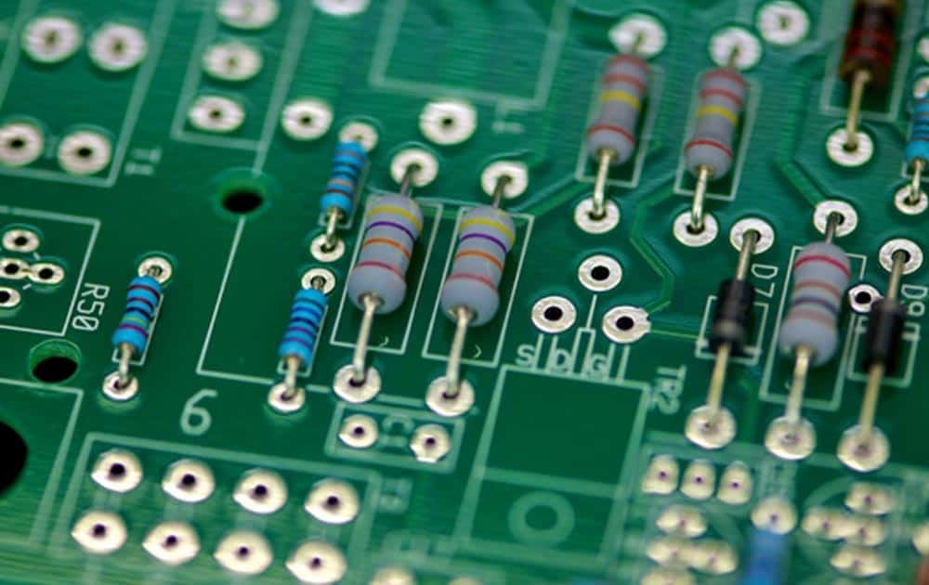
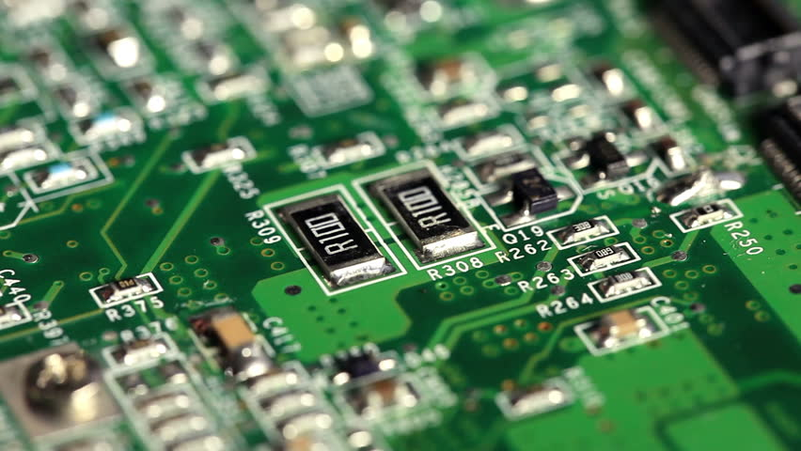
Printed Circuit Boards (PCBs)
A way to construct more electrically complex circuits that are impractical for a breadboard
Have a wide range of components (sensors, MCUs, power circuit components) that are often surface mount (SMD) rather than through hole
Through Hole
Surface Mount
Notes:
Week 1 was focused on doing design with a breadboard and wires to make electrical components. With more components this gets too complicated
Shift then to focus on PCBs which have the same range of components we have worked with earlier but we are able to make connections through copper traces on a 2D level
PCBs take advantage of SMD which are smaller to create more efficient designs

Slide 6
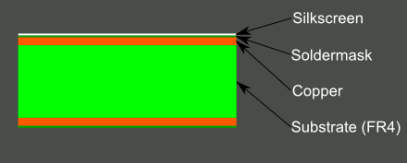
Layers
Work by having multiple different layers
Silkscreen - Text, labels, and graphics
Soldermask - repels solder, usually colored green
Copper - conductive materials
Substrate - for structure
Notes:
Instead of using wires and a breadboard we now have multiple layers of material on a 2D place
Silkscreen for text (for us usually white) that will help us with soldering
Soldermask aka the green stuff that doesnt get soldered
Copper actually makes the electrical connections throught traces and vias
Substrate provides structure

Slide 7
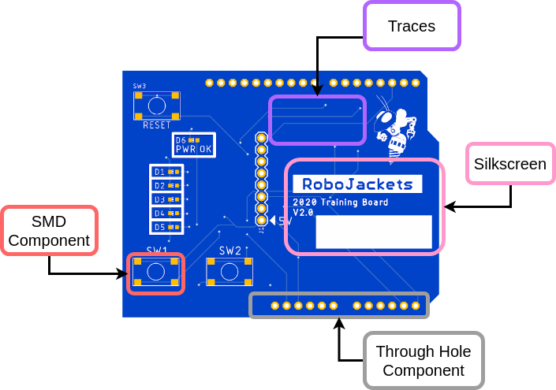
PCB Features
Training Board
Notes:
The PCB you will be interacting with the next couple of days and edit the design of
Some notable features are pointed out
SMD component - can see copper pads to solder too
Through hole component, can see holes
Copper traces for connections
Silkscreen for label

Slide 8
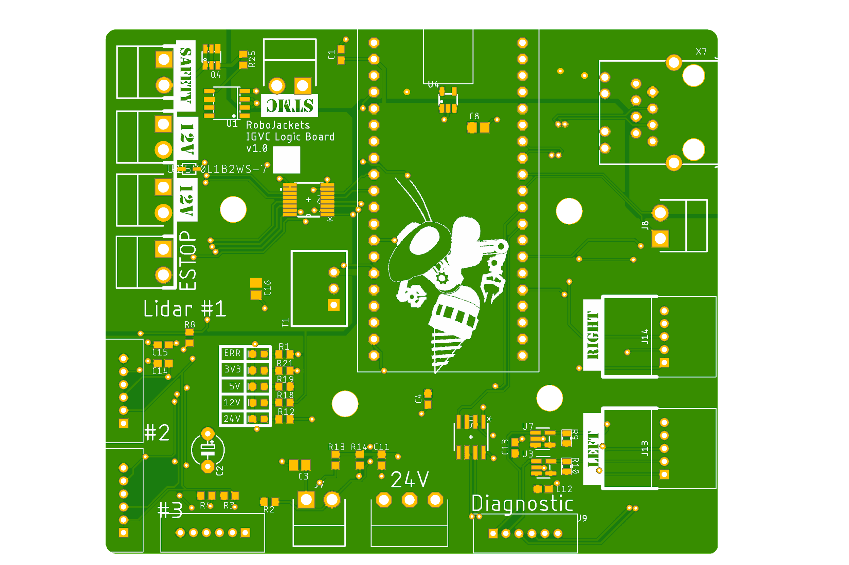
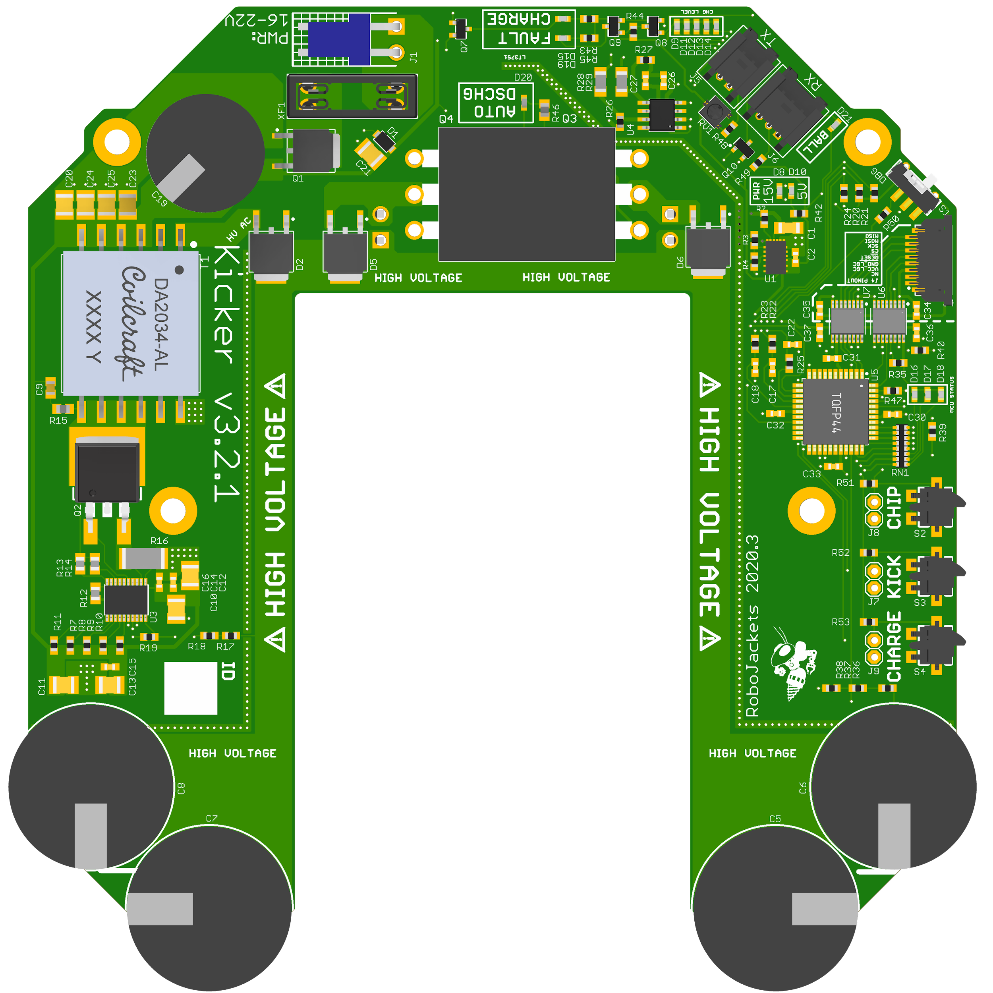
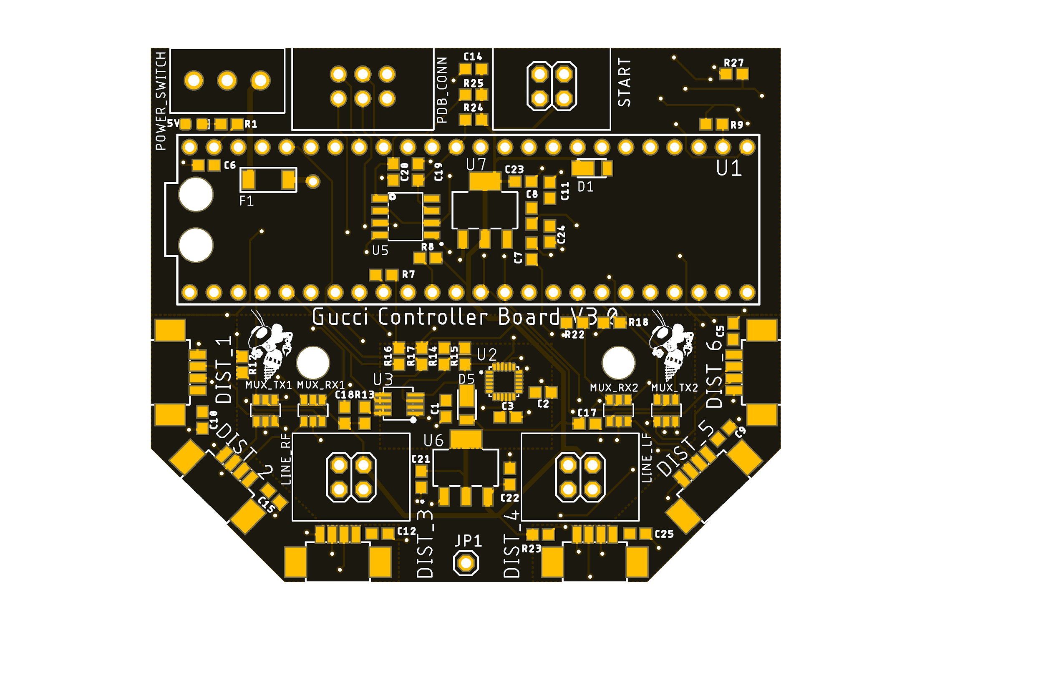
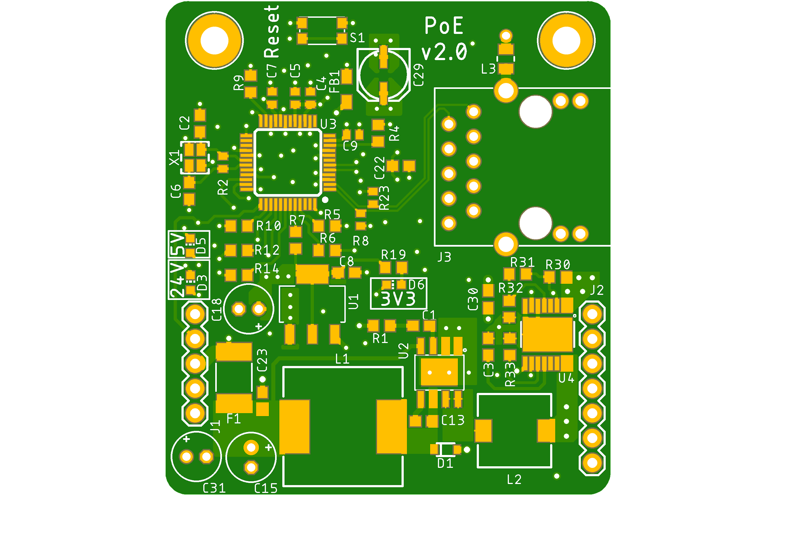
Team Examples
We use PCBs for a wide range of problems
Notes:
RW Control Board
RC Kicker Board
RR PoE
IGVC Logic Board

Slide 9
What is KiCad?
Where the magic happens

Slide 10
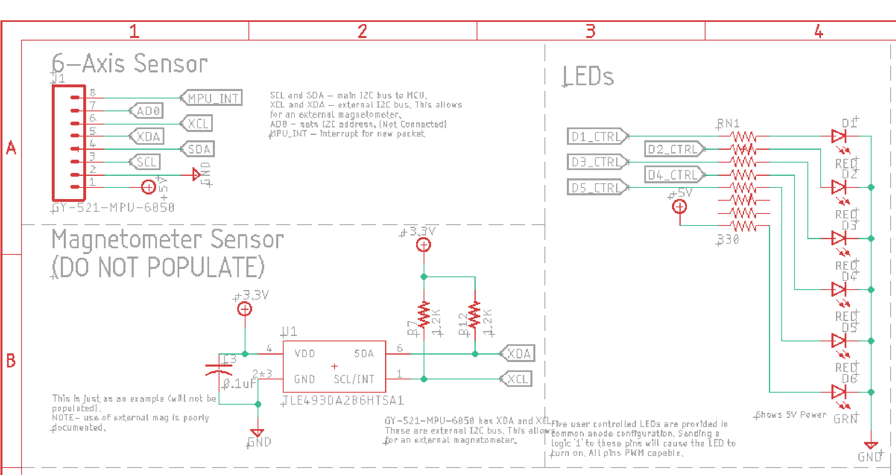
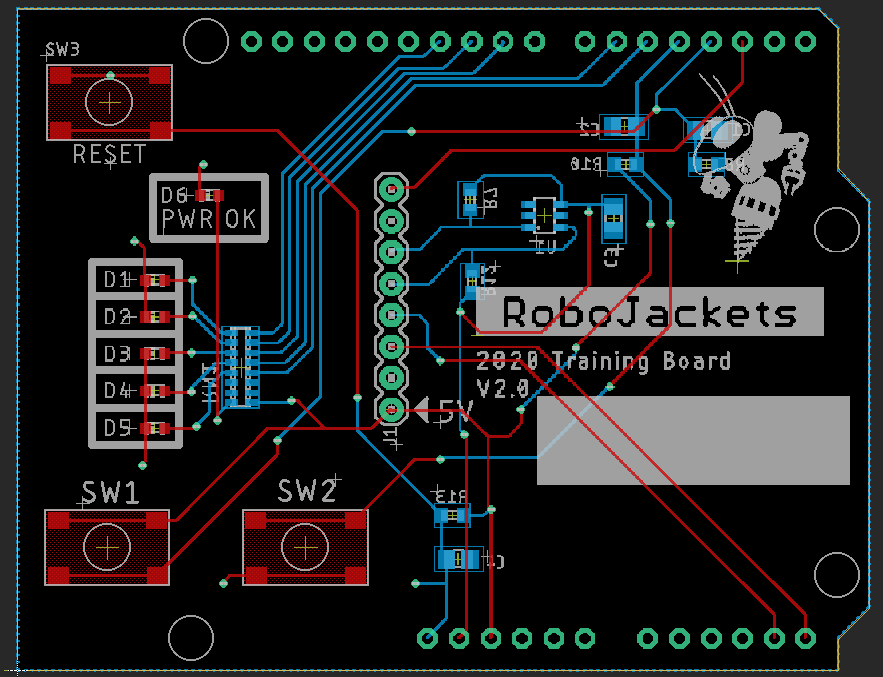
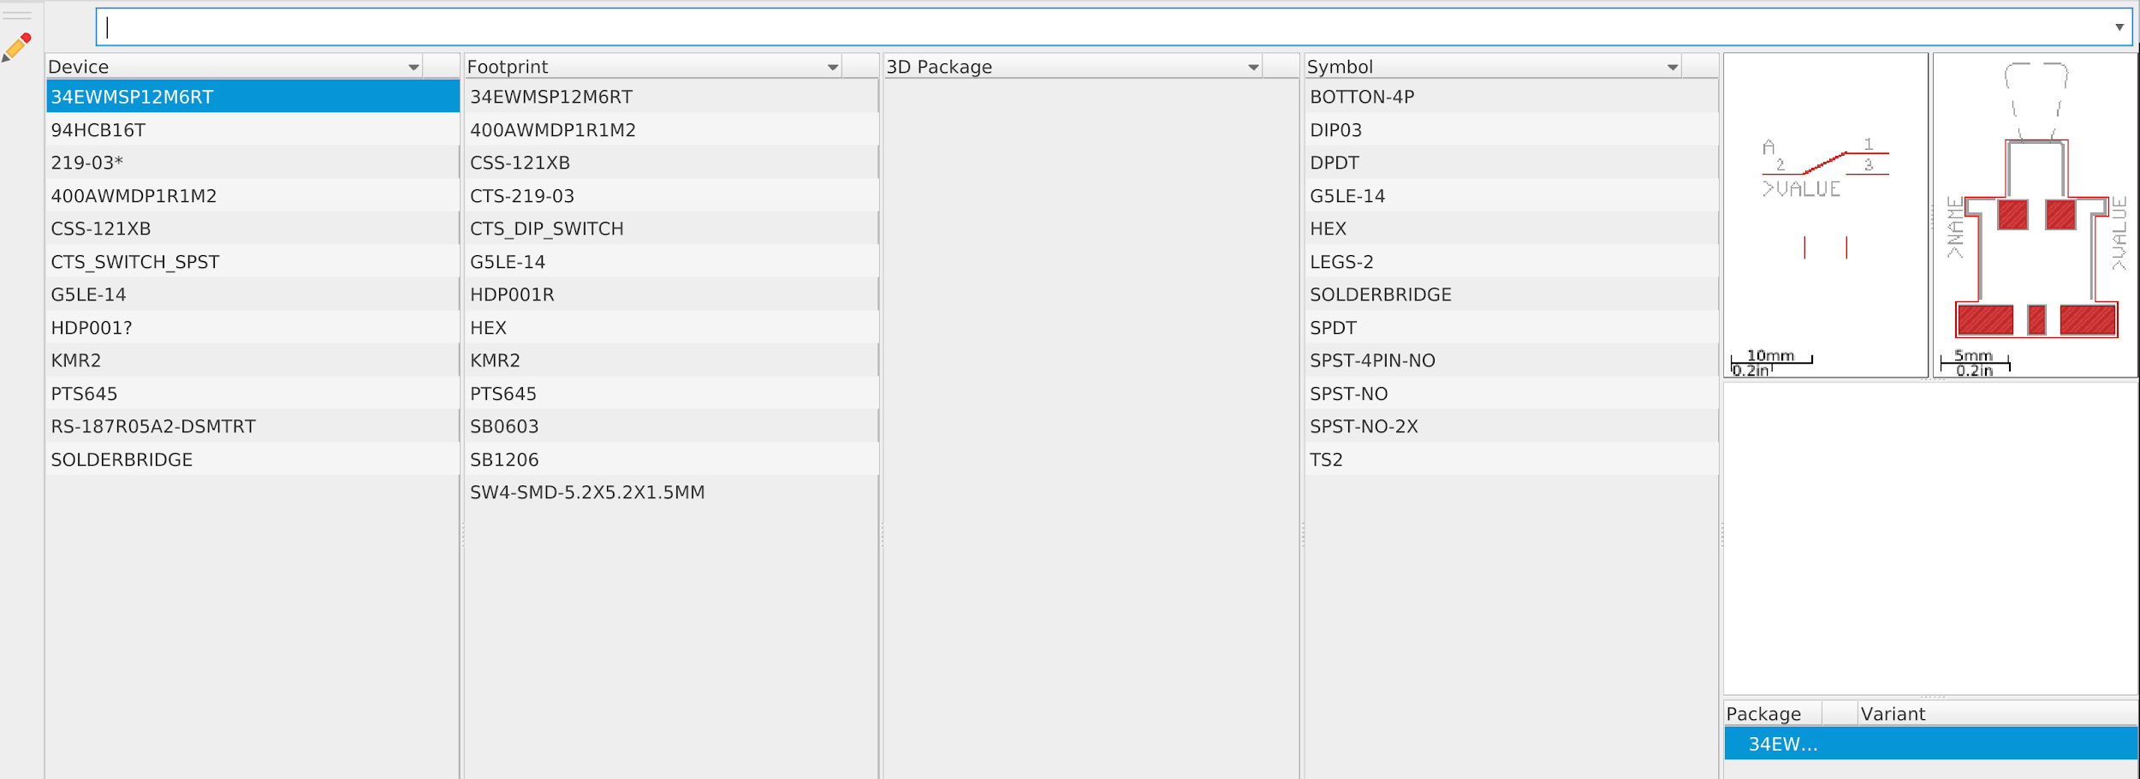
KiCad
Computer software to design PCBs
Three Stages of Development
Libraries & Parts
Schematics
Board Layout
Notes:
Libraries - Store the components that you will include on your board
Schematics - Defines circuits between all the components you have included
Board Layout - Defines the physical location of components and their physical connections

Slide 11
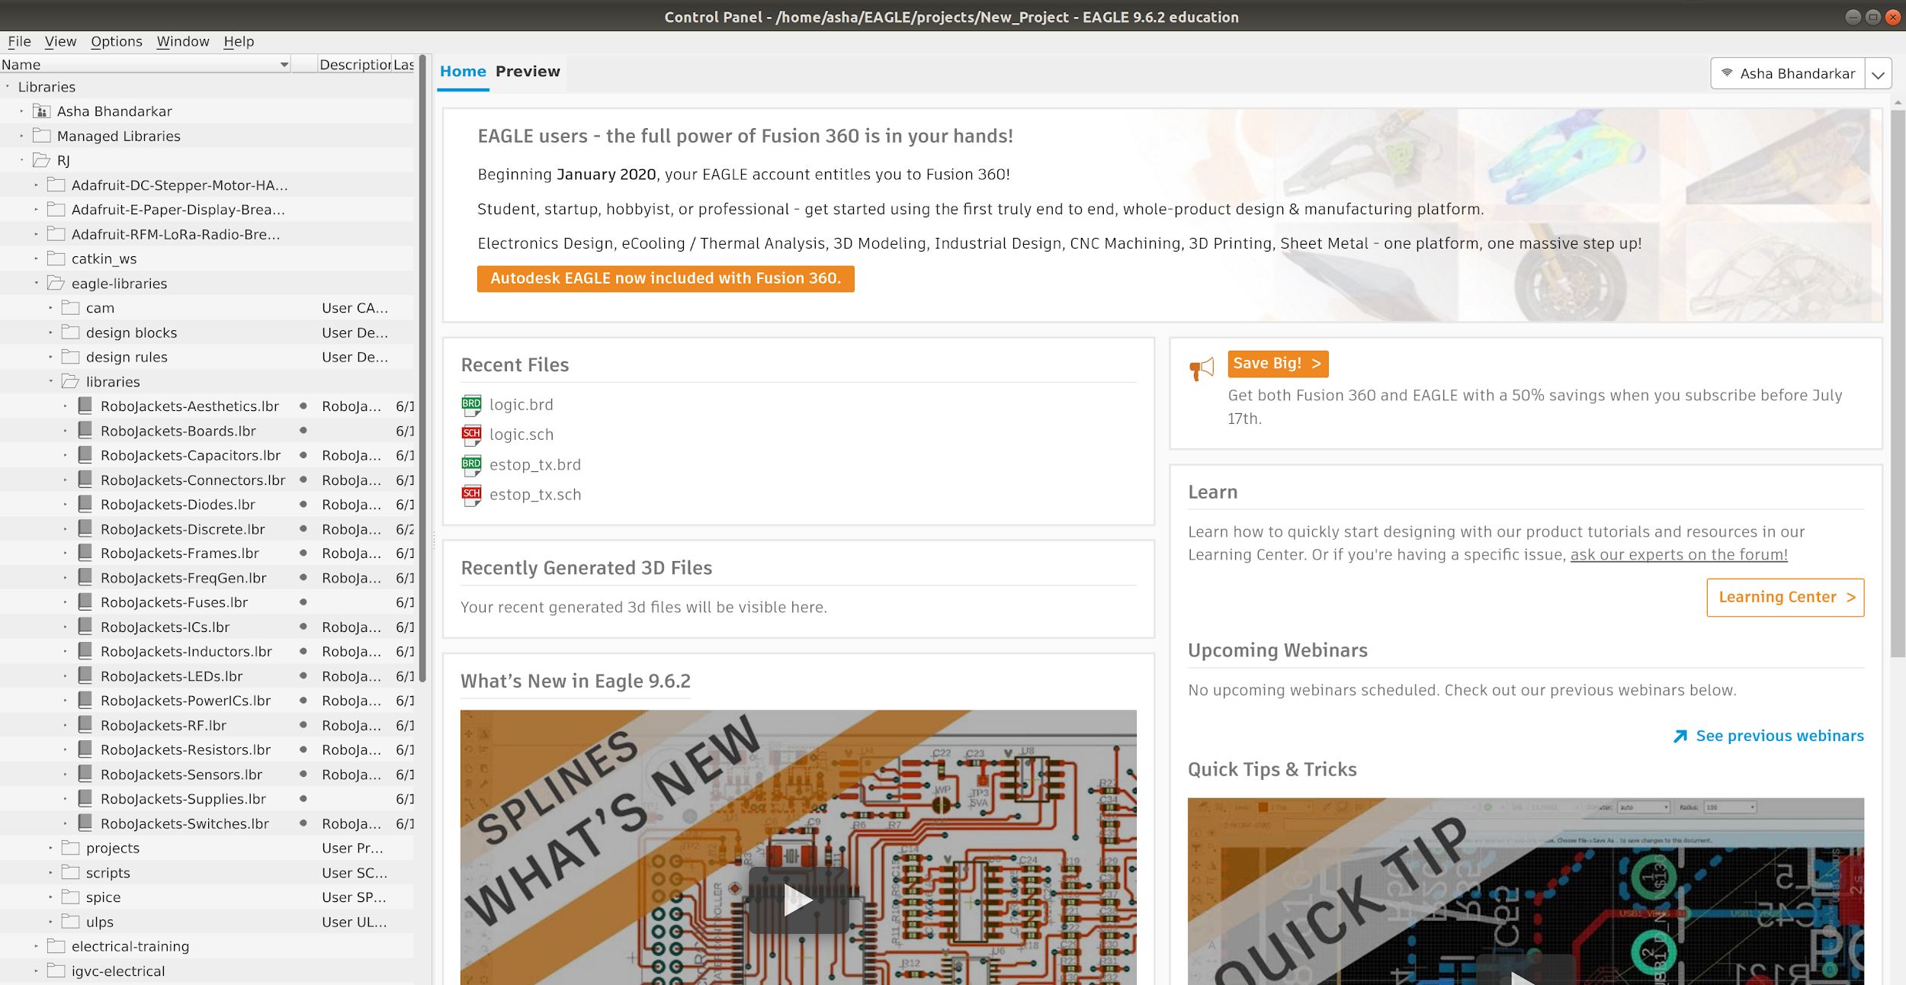
Control Panel
Notes:
Navigation window for EAGLE
Can access recent files, open files, make new files
On the right side I have shown my libraries which are designated with the book shaped icon

Slide 12
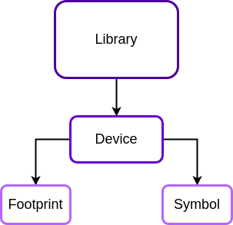
Libraries
Store various components used in projects
Libraries organize devices (electrical components) to be comprised of a symbol and footprint

Slide 13
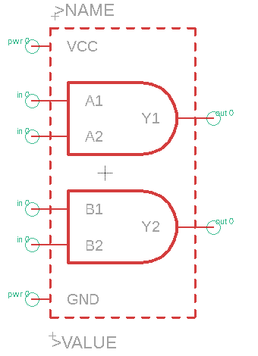
Symbol
Used in the schematic view to make circuit connections with other component symbols

Slide 14
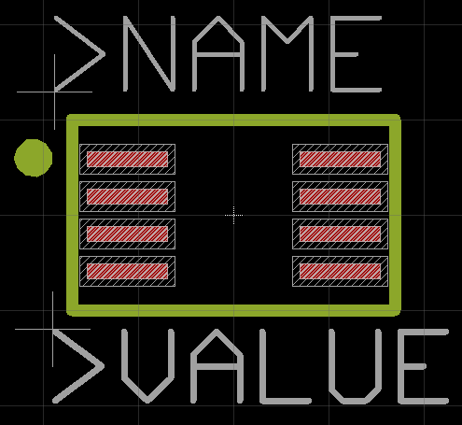
Footprint
Used in the the board layout view to make the actual physical connections between components

Slide 15
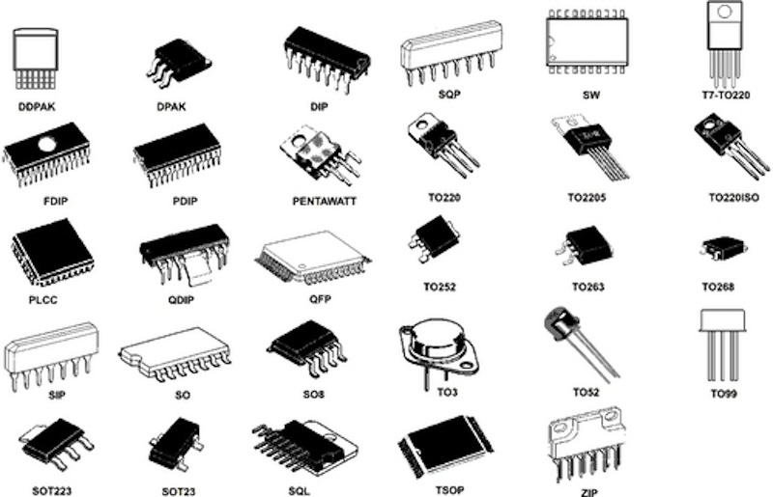
Common Packages
Many parts utilize industry standardized footprints so many different parts can have the same footprint
Notes:
Packages can be “copied and pasted” in EAGLE once you know the package your component comes in.

Slide 16
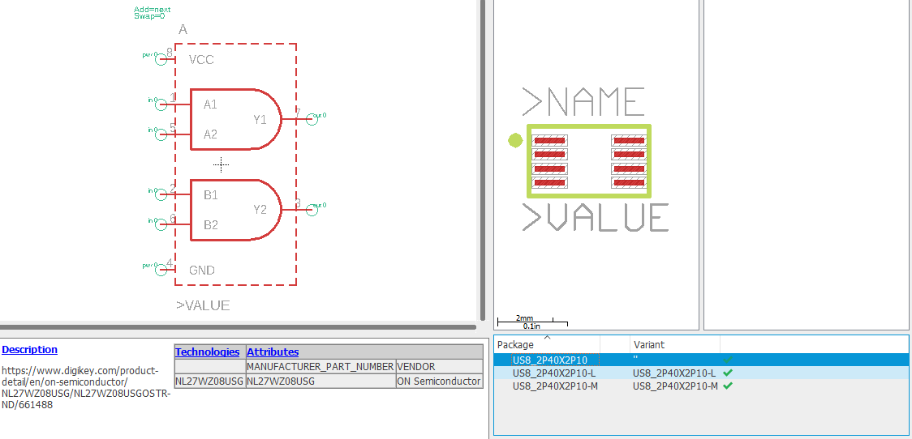
Device
Links the symbol and footprint together by mapping the symbol’s pins to the footprint pins
A symbol can have multiple footprints if the component comes in multiple different packages (common with ICs)

Slide 17
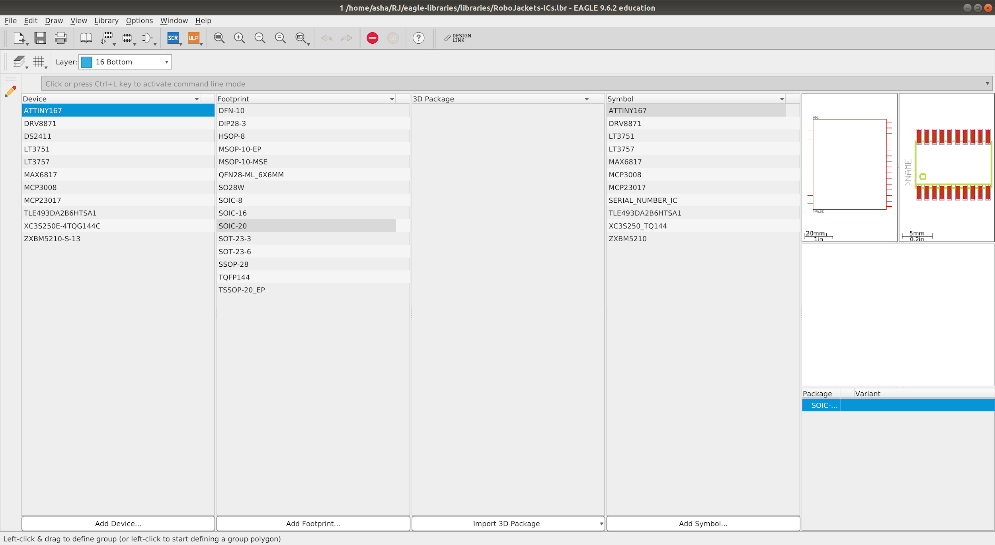
Example Library

Slide 18
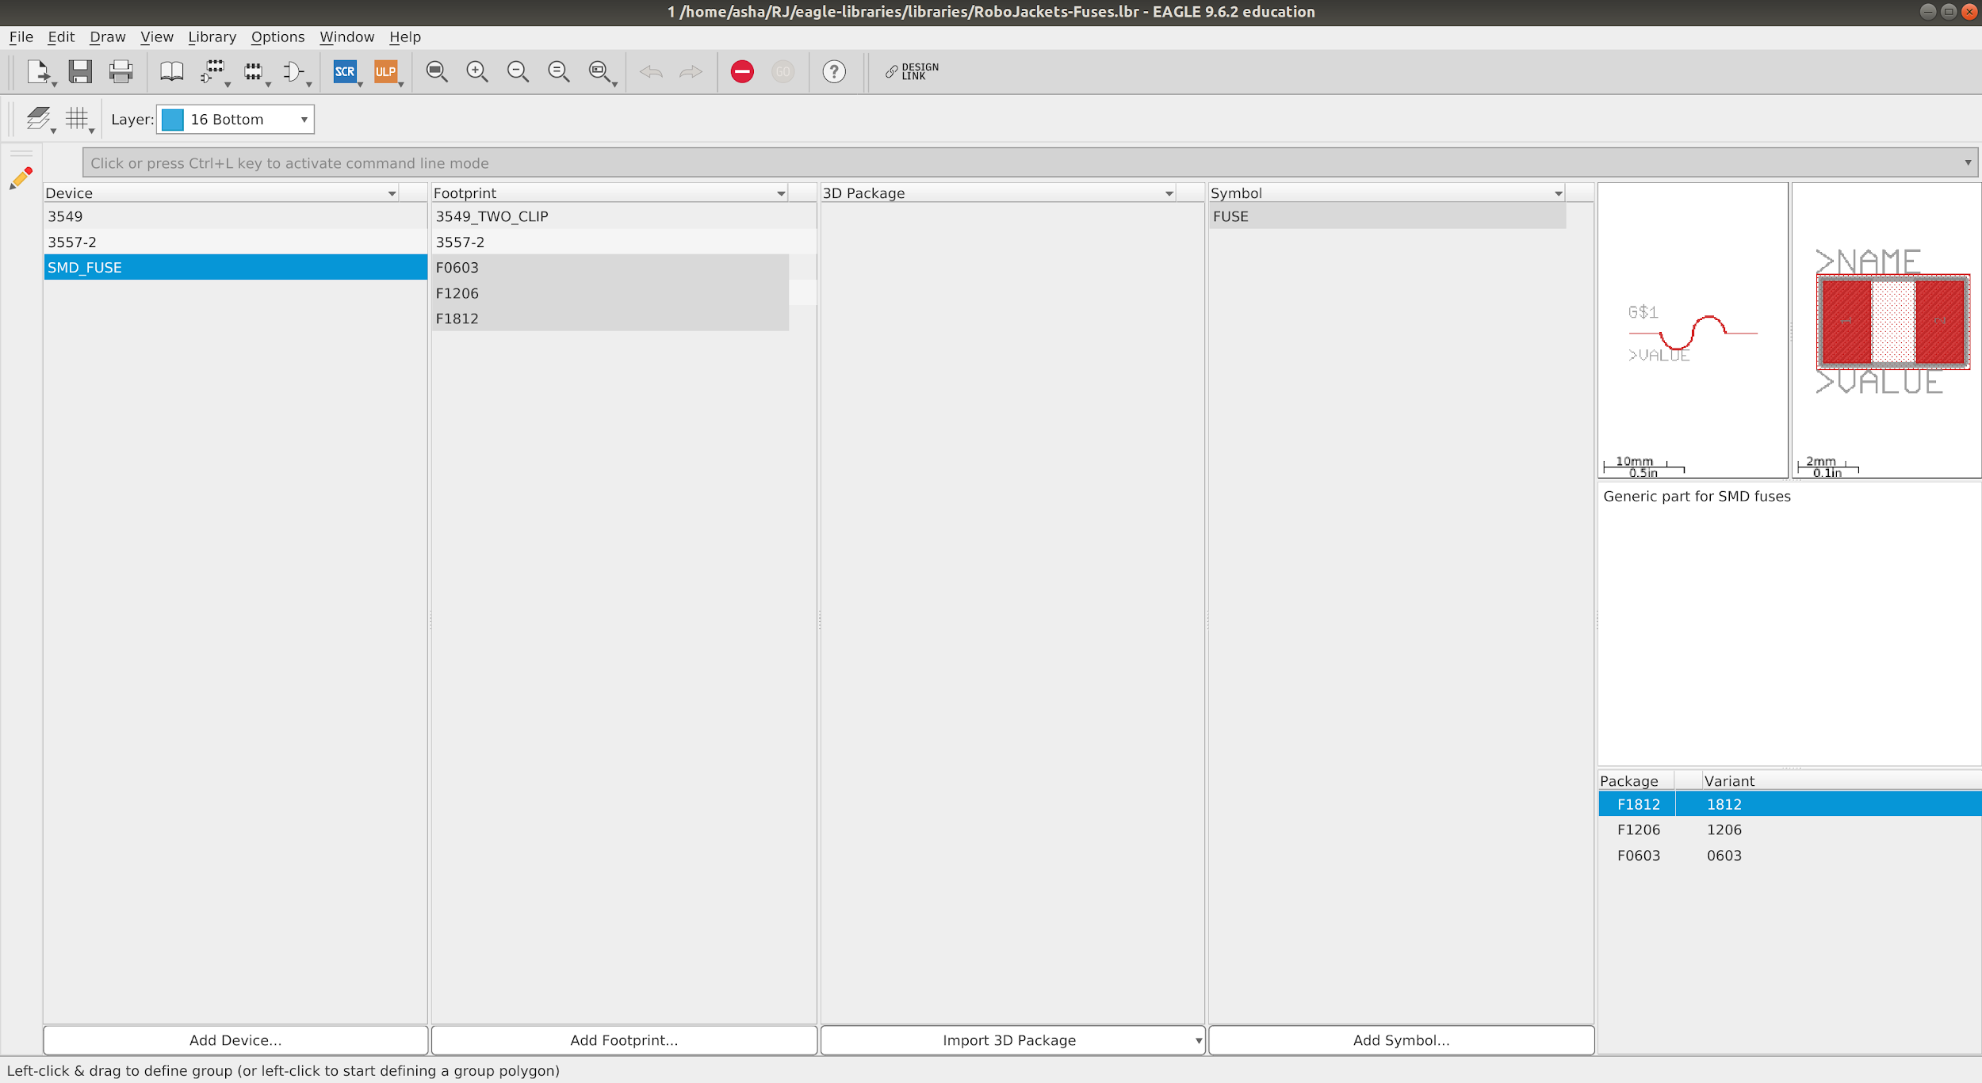
Example Library
A component with multiple footprints

Slide 19
Lab!
Setup + Making a Part in KiCad

Slide 20
Installing Software
EAGLE
Requires Autodesk account registered with GT email (click “Get Started”)
https://www.autodesk.com/education/edu-software/overview
Download here
https://www.autodesk.com/products/eagle/free-download

Slide 21
Adding Repositories
Adding the #eagle-libraries repository where RJ parts are stored
You will be using Github Desktop for this
https://desktop.github.com

Slide 22
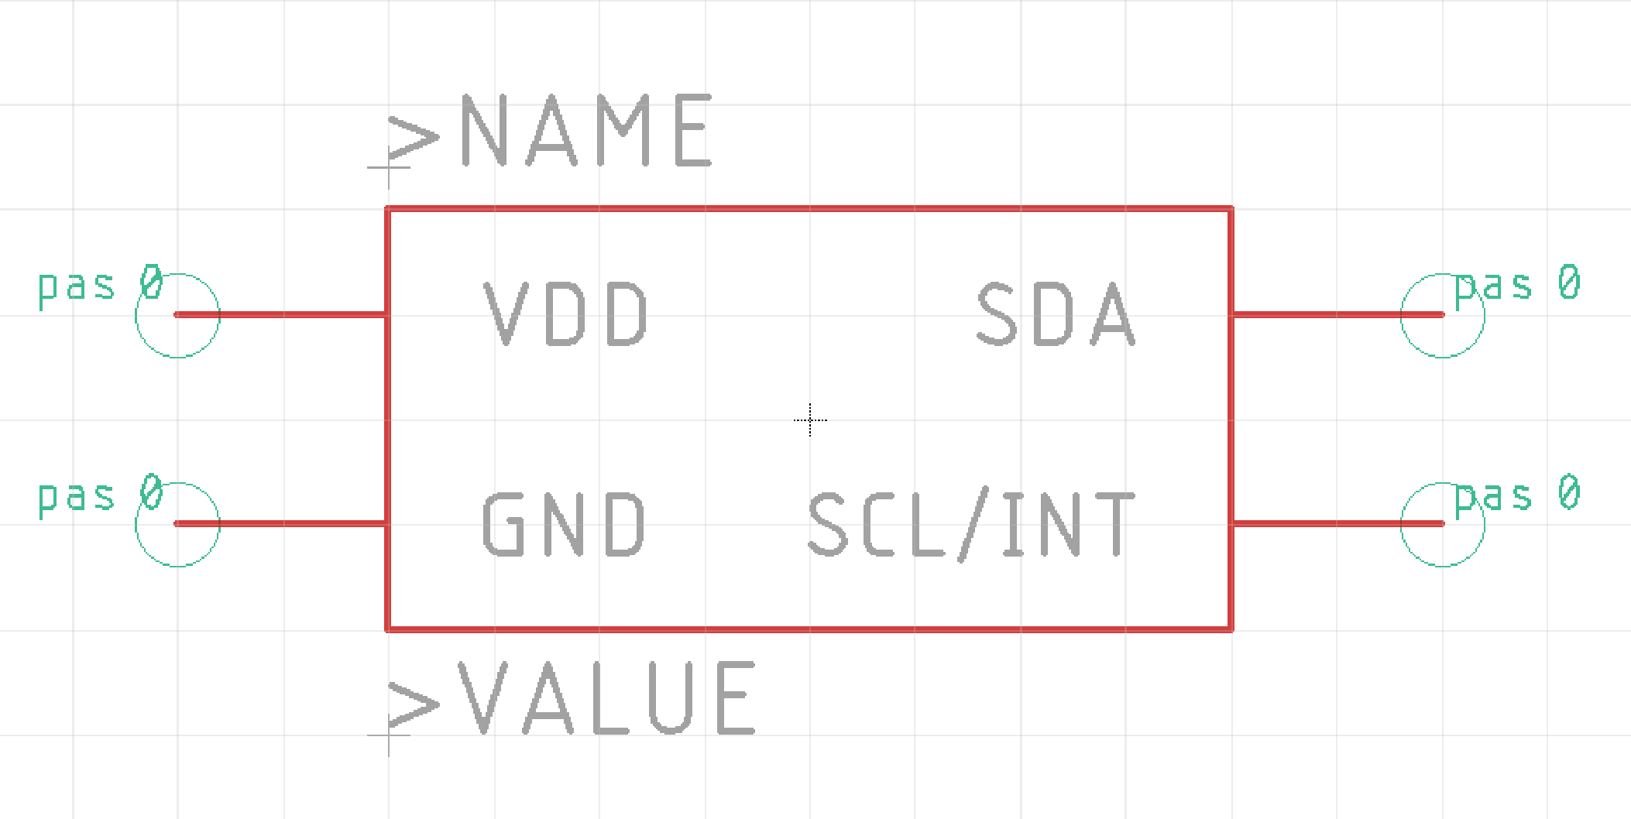
Making a Part - Symbol
Based on pin configuration in the datasheet create similarly named pins and create an outline

Slide 23
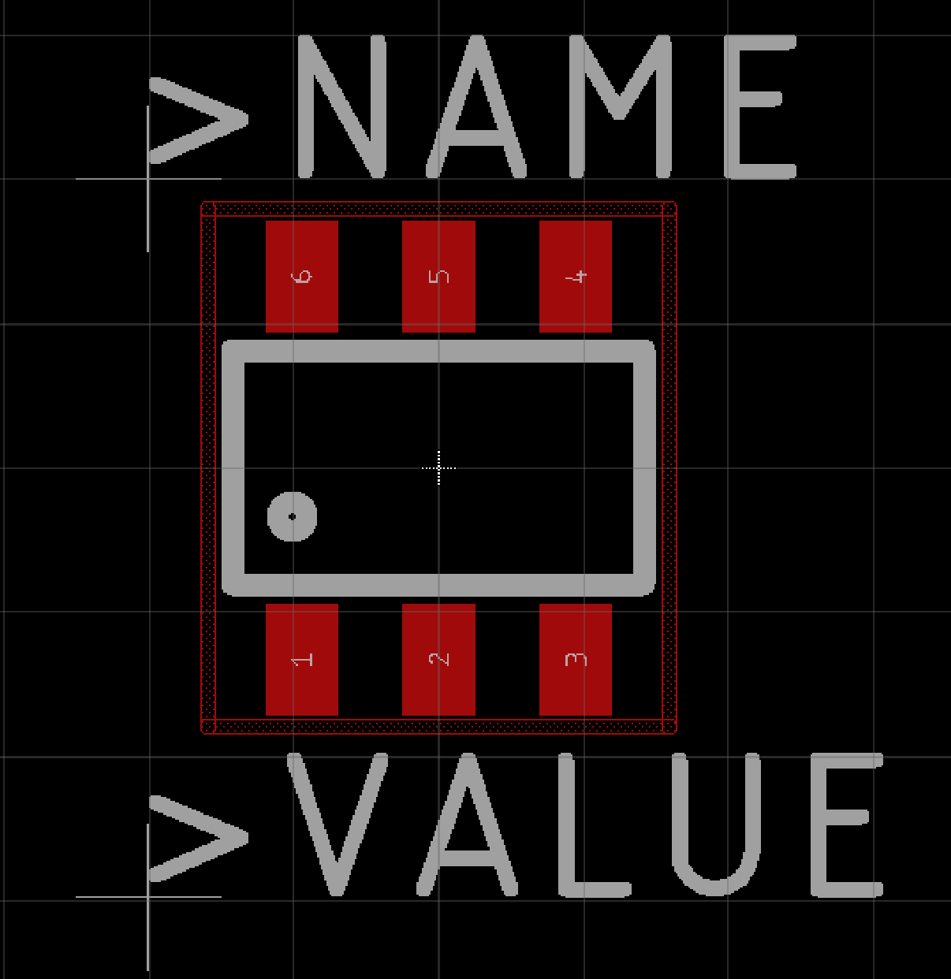
Making a Part - Footprint
Create a physical representation of the the part by reading the package outline details in the datasheet and then placing correctly sized pads/drills at the appropriate location

Slide 24
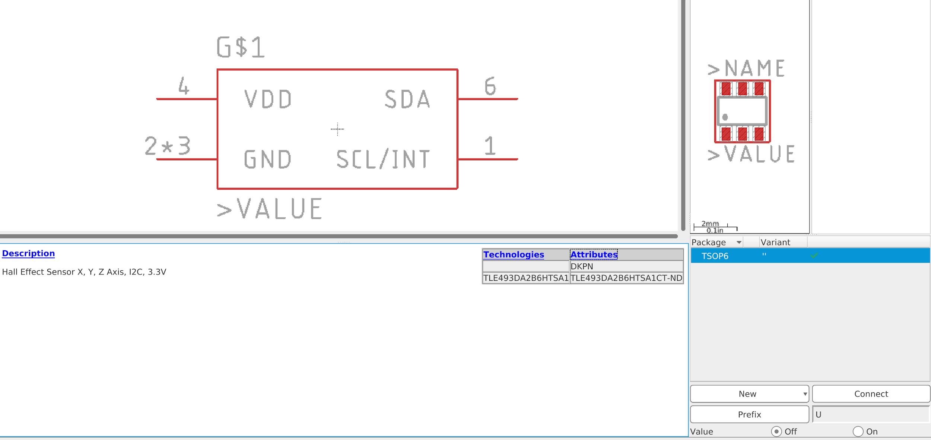
Making a Part - Device
Map the symbol’s pins to the footprint’s pads, add prefix, and add descriptive information

Slide 25
Thank You!
Any Questions?

